Slide 1
Word embeddings
Text processing with current NNs requires encoding into vectors.
One-hot encoding:
N words encoded by length N vectors.
A word gets a vector with exactly one entry = 1, others 0.
Very space inefficient, no natural language structure.
Bag of words:
Collection of words (along with number of occurences).
No word order, no natural language structure.

Slide 2
Word embeddings: idea
Idea: learn an embedding from words into vectors
Prior work:
Learning representations by back-propagating errors. (Rumelhart et al., 1986)
A neural probabilistic language model (Bengio et al., 2003)
NLP (almost) from Scratch (Collobert & Weston, 2008)
A recent, even simpler and faster model: word2vec (Mikolov et al. 2013)
http://colah.github.io/posts/2014-07-NLP-RNNs-Representations/

Slide 3
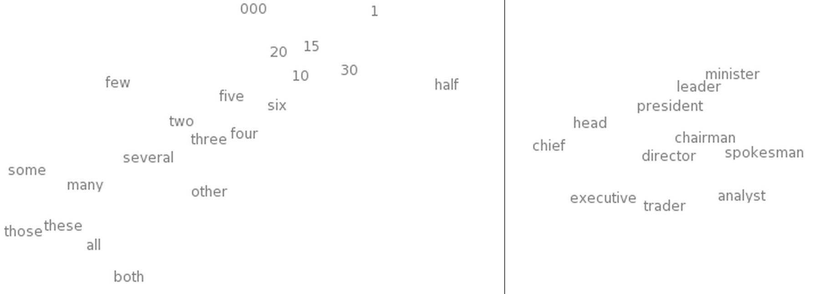
Word embeddings: similarity
Hope to have similar words nearby
http://colah.github.io/posts/2014-07-NLP-RNNs-Representations/

Slide 4
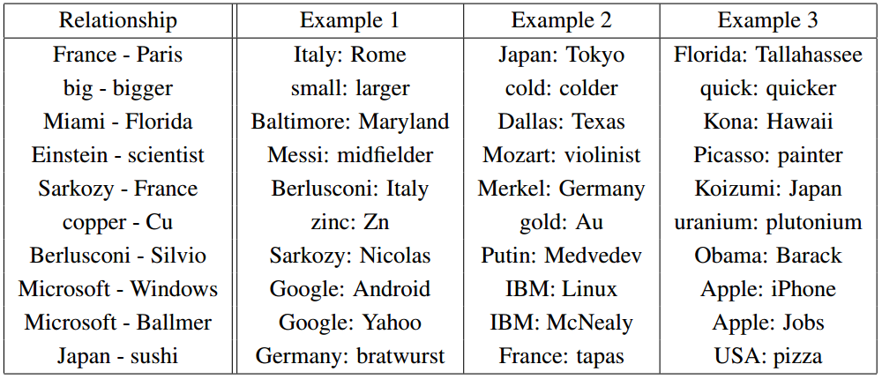
Word embeddings: relationships
Hope to preserve some language structure (relationships between words).
http://colah.github.io/posts/2014-07-NLP-RNNs-Representations/

Slide 5
Word embeddings: properties
Need to have a function W(word) that returns a vector encoding that word.
Similarity of words corresponds to nearby vectors.
Director – chairman, scratched – scraped
Relationships between words correspond to difference between vectors.
Big – bigger, small – smaller

Slide 6
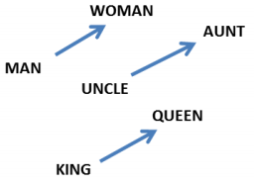

Word embeddings: properties
Relationships between words correspond to difference between vectors.
http://colah.github.io/posts/2014-07-NLP-RNNs-Representations/

Slide 7
Word embeddings: questions
How big should the embedding space be?
Trade-offs like any other machine learning problem – greater capacity versus efficiency and overfitting.
How do we find W?
Often as part of a prediction or classification task involving neighboring words.

Slide 8
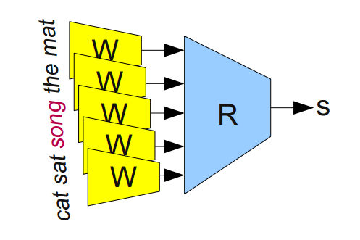
Learning word embeddings
First attempt:
Input data is sets of 5 words from a meaningful sentence. E.g., “one of the best places”. Modify half of them by replacing middle word with a random word. “one of function best places”
W is a map (depending on parameters, Q) from words to 50 dim’l vectors. E.g., a look-up table or an RNN.
Feed 5 embeddings into a module R to determine ‘valid’ or ‘invalid’
Optimize over Q to predict better
https://arxiv.org/ftp/arxiv/papers/1102/1102.1808.pdf
http://colah.github.io/posts/2014-07-NLP-RNNs-Representations/

